Slide 1




TransactionandIsolationLevel
Boosting End-to-End Database Isolation Checking via Mini-Transactions
Hengfeng Wei, Jiang Xiao, Na Yang，Si Liu, Zijing Yin，Yuxing Chen, Anqun Pan
nayang@smail.nju.edu.cn
May 23，2025
Notes:
Good morning everyone. I’m Yangna from nanjing university. Today, I’m excited to present our ICDE 2025 paper titled “Boosting End-to-End Database Isolation Checking via Mini-Transactions”This is a joint effort by researchers from Nanjing University, ETH, and Tencent.

Slide 2
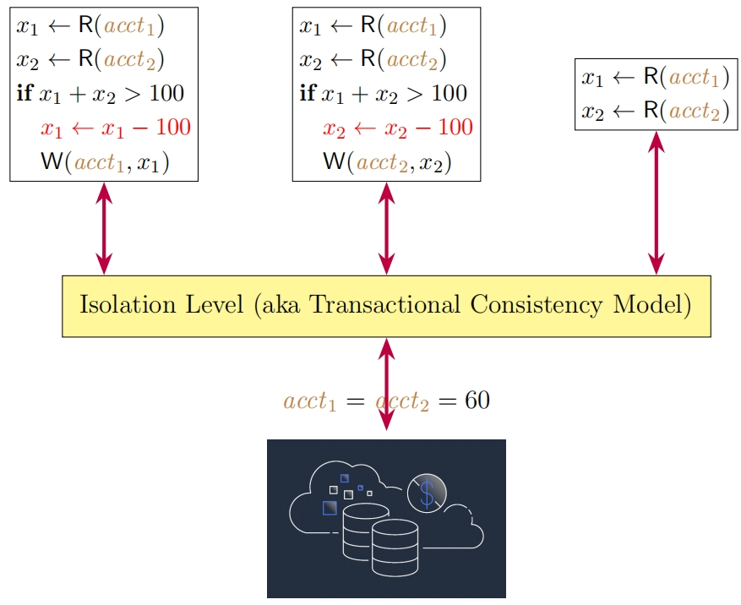
Transaction and Isolation Level
A transaction is a group of operations that is executed atomically.
The isolation levels specify how concurrent transactions are isolated from each other.
Notes:
Let's start with some background.
We define a transaction as a pair consisting of a set of operations and a strict total order over them, which we call the program order.Transactions are issued by clients and grouped into sessions—each session being a sequence of transactions.
In transactional databases, isolation levels define how concurrently executed transactions interact with each other.
They control the visibility of intermediate results and help prevent anomalies such as dirty reads, lost updates, or write skew.

Slide 3
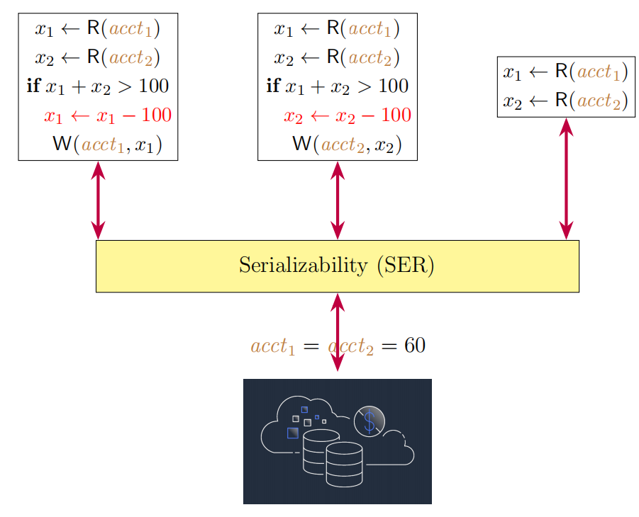
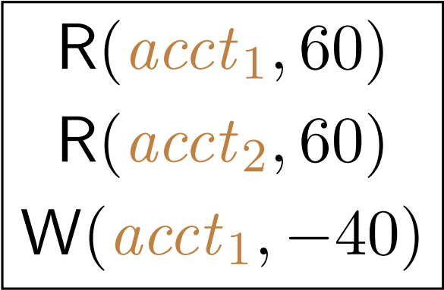
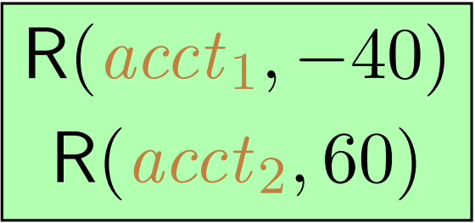
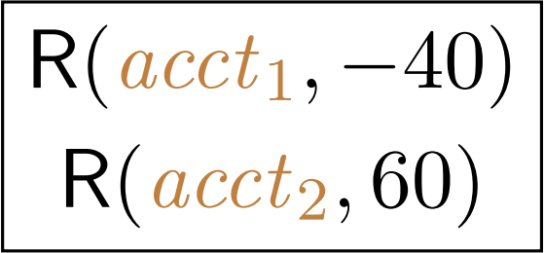
Serializability (SER)
SER, ensures that all transactions appear to execute sequentially, one after another.
Notes:
Our approach is mainly for strong isolation levels, including strict serializability,serializability, and snapshot isolation.
We will take serializability as an example.
Serializable is the strongest widely implemented isolation level.
It guarantees that the outcome of concurrent transactions is equivalent to some serial execution.
As shown in the figure, on the surface, concurrent transactions are interleaving with the database, but in fact, concurrent transactions are executed serially.

Slide 4
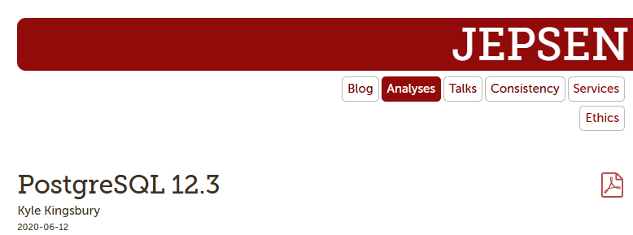

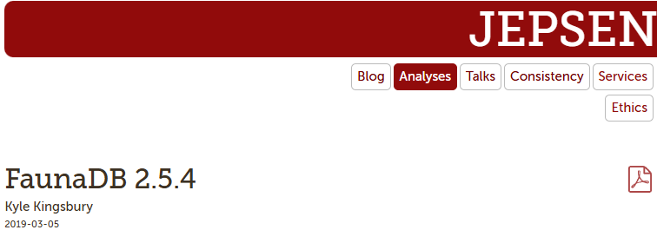

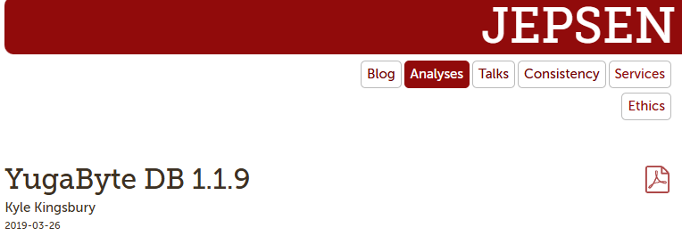
Database Systems and Serializability
Database systems may fail to provide Serializability correctly.
Notes:
However, recent studies have uncovered numerous isolation bugs in many production databases, raising concerns about whether these databases actually uphold their promised isolation guarantees in practice. Isolation bugs are very difficult to detect, as they often produce incorrect results without any explicit errors.
The above pictures are all reports of databases that violate the Serializability isolation level found by Jepsen.

Slide 5



Black-box Checking(End to End)
✅
❌
Verification ④
Isolation
Checker
③
Unified History
Client
Client
History Generation
History Verification
②
Exec.
Results
①
Workload
Database
Black-box database isolation checking involves two stages:
history generation (Steps 1 , 2 and 3 ) and history verification (Step 4 )
Notes:
Black-box database isolation checking involves two stages: history generation (Step 1 , 2 ,and 3 ) and history verification (Step 4 ).
First, clients send transactional requests to the database(Step 1), treating it as a black-box system.
Each client records the requests sent to the database along with the corresponding results received (Step 2).
The logs from all clients are combined into a single history, which is provided to the isolation checker (Step 3 ).
Finally, the checker performs history verification, deciding whether the history satisfies the specified isolation level. If isolation violations are detected, some checkers offer counterexamples (Step 4 ).

Slide 6
General Transaction (GT)
Black-box checkers often use randomized testing with General Transaction (GT) workloads:
Randomly generated transaction of large sizes:
High abort rates under high concurrency
Expensive to verify [R. Biswas:OOPSLA, 2019],it have been shown to be NP-hard under strong isolation levels(e.g. SER)
History Generation
History Verification
Notes:
General transaction workloads are widely used in randomized isolation testing, but they face serious efficiency challenges.
First, executing many concurrent GTs creates high overhead—especially under strong isolation levels—due to frequent transaction aborts or costly locking.This will result in a large amount of checking overhead during history generation.
Second, GT histories produce large and dense dependency graphs, which are expensive to verify.This will result in a large amount of checking overhead during history verification.

Slide 7
Reseach Question:
How to boost end-to-end database isolation checking ?
Reducing overhead during history generation by minimizing database blocking and transaction retries
By read-modify-write pattern and highly efficient algorithms to reduce overhead during history verification
History Generation
History Verification
Notes:
So how to boost end-to-end database isolation checking ?
We address these inefficiencies through the novel design of Mini-Transactions. MTs are compact, short transactions that execute much faster than general workloads, reducing overhead during history generation by minimizing database blocking and transaction retries. By leveraging MTs’read-modify-write pattern, we develop highly efficient algorithms to verify strong isolation levels in linear or quadratic time.

Slide 8
Read-Modify-Write pattern
RMW: each write operation is preceded by a read operation on the same object
Benefits of RMW：
Simplify dependency analysis and reduce verification overhead
Make WW dependencies nearly deterministic in MTs
Verify SSER, SER, and SI on MT histories takes linear or quadratic time
Notes:
However, even with these improvements in execution time,efficient verification against strong isolation levels remains challenging due to the potential for large transaction numbers,which generate dense dependency graphs.
1、To address this issue, we design MTs to adhere to the read-modify-write(RMW) pattern, where each write operation is preceded by a read operation on the same object.
2、since each write operation is preceded by a read operation on the same object in mini-transactions, the write-write conflict is almost determined.
3、Despite the NP-hardness of verifying strong isolation levels for general histories , we enable highly efficient algorithms in linear or quadratic time to verify strong isolation levels over MT histories，thanks to the read-modify-write pattern in MTs and the unique value conditions in MT histories.

Slide 9
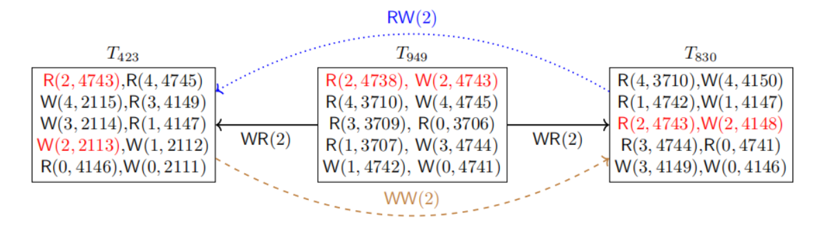
Motivation
10 sessions × 100 transactions × 10 operations per transation
VS
core anomaly only involves 3 transactions with 2 operations each
Notes:
Our insight behind the MT-based description of anomalies is that, while isolation violations have been detected in GT workloads of substantial size, these violations are typically due to a small subset of operations within a limited number of transactions. For example, Figure illustrates an SI violation identified in MariaDB.The corresponding GT workload comprises 10 sessions, each containing 100 transactions, with each transaction performing 10 operations. However, as highlighted in red, the core of this bug involves only three transactions, each with two operations,which can be represented by our MTs.

Slide 10
Contributions:
Propose a unified approach centered on MTs to address inefficiencies in both history generation and history verification.
Design MTs to capture all 14 known anomalies and develop efficient verification algorithms using RMW patterns and unique values.
Implement MTC tool that outperforms existing checkers and effectively detects bugs in real databases.
Notes:
Our contributions are three-fold:
First, at the conceptual level, we propose a unified MT-based approach that addresses inefficiencies in both history generation and verification in black-box isolation checking.
Second, at the technical level, we design Mini-Transactions that are compact yet semantically rich—capable of capturing all 14 well-known isolation anomalies.
We develop efficient verification algorithms using the read-modify-write pattern and unique values, and prove that verifying strong isolation without unique values is NP-hard.
Third, at the practical level, we implement our techniques in a tool called MTC, which includes both an MT workload generator and verifier.Experiments show that MTC significantly outperforms state-of-the-art tools in end-to-end checking, and effectively detects real-world bugs across isolation levels.

Slide 11
Mini-Transactions
Mini-Transactions :
Each transaction has ≤ 4 operations
Follows the Read-Modify-Write (RMW) pattern
Mini-Transaction History:
Contains only mini-transactions (except ⊥T)
Each write to the same object uses a unique value
History Generation
History Verification
Question: Can MTs capture common isolation anomalies?
Notes:
A mini-transaction is a transaction meeting the following two rules:
• It contains one or two read operations and at most two write operations.
• Each write operation, if present, is preceded by a read operation on the same object.
A mini-transaction history is a history comprising solely mini-transactions such that each write operation on the same object assigns a unique value.
The first rule of mini-transactions helps expedite database execution during history generation, while the second rule, along with the unique values written, guarantees the existence of efficient verification algorithms for mini transaction histories.

Slide 12
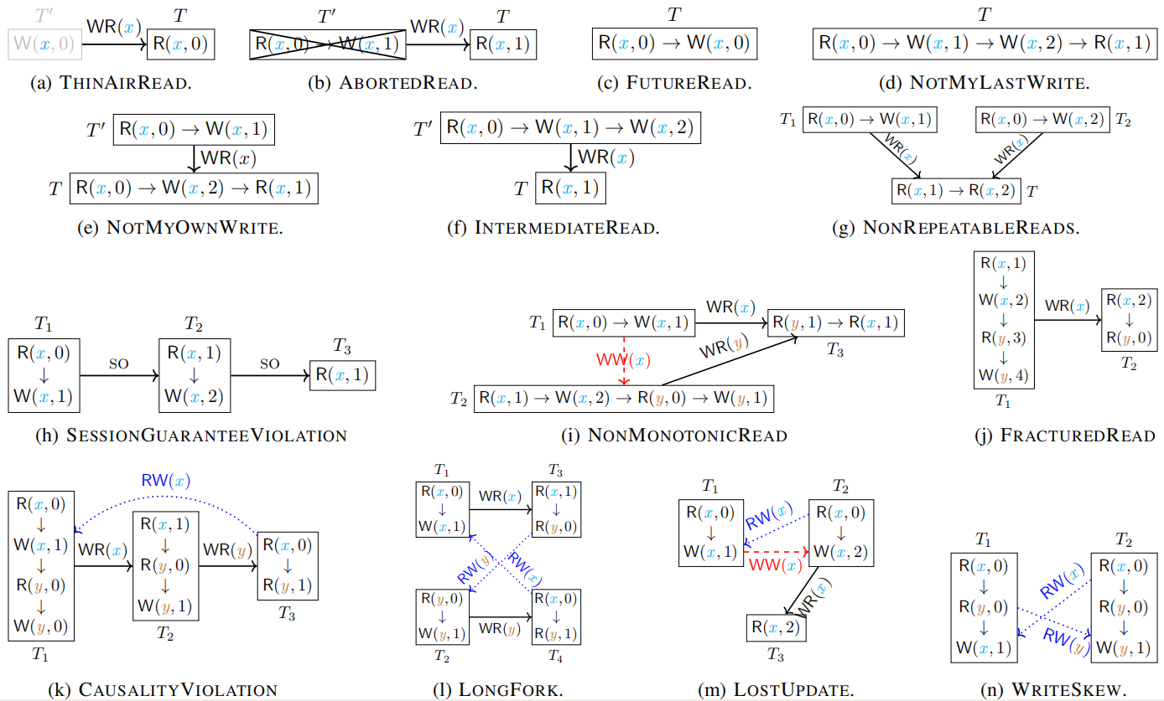
MTs are highly expressive to characterize all common isolation anomalies.
Mini-Transactions :
Each transaction has ≤ 4 operations
Follows the Read-Modify-Write (RMW) pattern
Notes:
Despite their simplicity, MTs are semantically rich enough to capture common isolation anomalies that can occur in GT histories. These encompass all 14 well-known isolation anomalies.For example, common anomalies such as LostUpdate and WriteSkew, and more complex anomalies such as CausalityViolation.

Slide 13
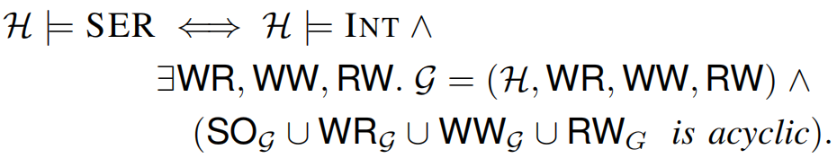
Dependency Graph based Characterization of SER
A history H satisfies SER, denoted H |= SER, if and only if it satisfies INT and one of its dependency graphs is acyclic.
Notes:
As before, we will take serializability as an example.
A history satisfies SER, if and only if it satisfies INT and one of its dependency graph which includes SO edge,WR edge,WW edge and RW edge is cycle-free.Now, let's look an example.

Slide 14
Dependency Graph based Characterization of SER
T_{A}
R(acct,0)
W(acct,50)
T₀
WR
T’_{A}
W(acct,0)
R(acct,25)
WR
WR
R(acct,0)
W(acct,25)
T_{B}
WR: “write-read” dependency capturing the “read-from” relation
Notes:
As shown in the figure,Transaction T₀ writes the acct object, and then transactions T_{A} and T_{B} respectively read the acct object written by T₀ . We say that T_{A} and T_{B} read-depends on T₀ . We will add WR dependency edges from T₀ to T_{A} and T₀ to T_{B} in the Dependency Graph.

Slide 15
Dependency Graph based Characterization of SER
T_{A}
WW
R(acct,0)
W(acct,50)
T₀
WR
T’_{A}
W(acct,0)
R(acct,25)
WR
WR
WW
R(acct,0)
W(acct,25)
T_{B}
WW: “write-write” dependency capturing the version order on acct
Notes:
T₀ write the acct object, and then T_{A} and T_{B} respectively wirte the acct object written by T₀ . We say that T_{A} and T_{B} wirte-depends on T₀ . We will add WW dependency edges from T₀ to T_{A} and T₀ to T_{B} in the Dependency Graph.

Slide 16
Dependency Graph based Characterization of SER
T_{A} reads from T₀ which is overwritten by T_{B}
T_{A}
WW
R(acct,0)
W(acct,50)
T₀
WR
T’_{A}
W(acct,0)
RW
R(acct,25)
WR
WR
WW
R(acct,0)
W(acct,25)
T_{B}
RW: “read-write” dependency
Notes:
T_{A} reads the acct object from T₀ and then the object T_{A} reads is overwritten by T_{B} . We say that T_{B} anti-depends on T_{A} . We will add RW dependency edges from T_{A} to T_{B} in the Dependency Graph.

Slide 17
Dependency Graph based Characterization of SER
T_{B} reads from T₀ which is overwritten by T_{A}
T_{A}
WW
R(acct,0)
W(acct,50)
T₀
WR
T’_{A}
W(acct,0)
RW
RW
R(acct,25)
WR
WR
WW
R(acct,0)
W(acct,25)
T_{B}
RW: “read-write” dependency
Notes:
Similarly,T_{B} reads the acct object from T₀ and then the object T_{B} reads is overwritten by T_{A} . We say that T_{A} anti-depends on T_{B} . We will add RW dependency edges from T_{B} to T_{A} in the Dependency Graph.

Slide 18
Dependency Graph based Characterization of SER
T_{B} reads from T₀ which is overwritten by T_{A}
T_{A}
WW
R(acct,0)
W(acct,50)
T₀
WR
T’_{A}
W(acct,0)
RW
RW
R(acct,25)
WR
WR
WW
R(acct,0)
W(acct,25)
T_{B}
RW
RW
undesired cycle for SER:T_{A} T_{B} T_{A}
Notes:
At this point, undesired cycle for SER: T_{B} anti-depends on T_{A} and T_{A} anti-depends on T_{B} will occur.

Slide 19
Dependency Graph based Characterization of SER
ww
Suppose that T_{A} T_{B}
T_{A}
WW
R(acct,0)
W(acct,50)
T₀
WR
WW
T’_{A}
W(acct,0)
RW
RW
R(acct,25)
WR
WR
WW
R(acct,0)
W(acct,25)
T_{B}
WW
RW
undesired cycle for SER:T_{A} T_{B} T_{A}
Notes:
We will continue to perfect the Dependency Graph. We assume that T_{A} writes the acct object first and then T_{B} overwrites the acct object. We say that T_{B} write-depends on T_{A} . We will add WW dependency edges from T_{A} to T_{B} in the Dependency Graph.
At this point, undesired cycle for SER: T_{B} write-depends on T_{A} and T_{A} anti-depends on T_{B} will occur.

Slide 20
Dependency Graph based Characterization of SER
ww
Suppose that T_{B} T_{A}
T_{A}
WW
R(acct,0)
W(acct,50)
T₀
WR
WW
T’_{A}
W(acct,0)
RW
RW
R(acct,25)
WR
WR
WW
R(acct,0)
W(acct,25)
T_{B}
WW
RW
undesired cycle for SER:T_{B} T_{A} T_{B}
Notes:
Next,We assume that T_{B} writes the acct object first and then T_{A} overwrites the acct object. We say that T_{A} write-depends on T_{B} . We will add WW dependency edges from T_{B} to T_{A} in the Dependency Graph.
At this point, undesired cycle for SER: T_{A} write-depends on T_{B} and T_{B} anti-depends on T_{A} will occur.

Slide 21
Dependency Graph based Characterization of SER
ww
ww
We have considered both bases T_{A} T_{B}and T_{B} T_{A} ,
and each case leads to an undesired cycle for SER
T_{A}
R(acct,0)
W(acct,50)
T₀
WR
T’_{A}
W(acct,0)
R(acct,25)
WR
WR
R(acct,0)
W(acct,25)
T_{B}
Therefore, this history does not satisfy SER
Notes:
We have considered both bases T_{B} write-depends on T_{A} and T_{A} write-depends on T_{B} and each case leads to an undesired cycle for SER.We draw a conclusion that this history doesn't satisfy SER.

Slide 22
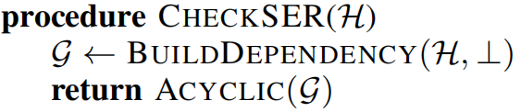
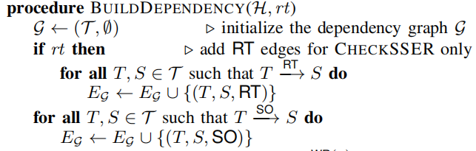
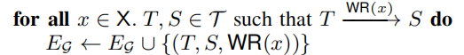
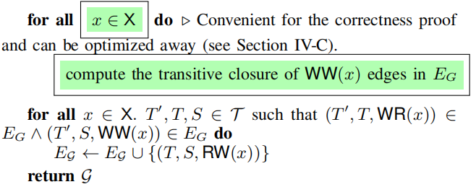
Mini-Transaction History Verification Algorithm
T_{A}
WW
R(acct,0)
W(acct,50)
WW
T’_{A}
T₀
WR
R(acct,25)
W(acct,0)
RW
RW
WR
WR
WW
R(acct,0)
W(acct,25)
T_{B}
Notes:
We will take serializability as an example to analyze the verification algorithm.
The algorithm construct the dependency graph G of the input history H based on the dependency relations SO, WR, WW, and RW by calling BuildDependency.
Due to unique values written, the WR dependency edges are entirely determined.
The WW dependency edges are inferred from the WR dependency.
Finally, the RW dependency edges are added based on the WR and WW dependencies. ﻿
Subsequently, we check whether the dependency graph G is cycle-free for SER.

Slide 23
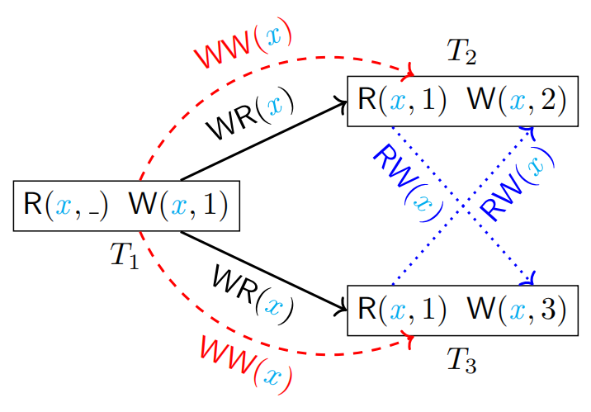
Algorithm Correctness
Verifying strong isolation levels is NP-hard without constraints
CHECKSI detects SI violations by identifying the DIVERGENCE pattern even when the dependency graph is acyclic (See figure)
Notes:
Our verification algorithms achieve linear or quadratic time for problems that are generally NP-hard. To justify this, we introduce formal correctness proofs. These proofs ensure that our optimizations do not compromise soundness or completeness. The correctness proofs of these three verification algorithms are surprisingly intricate and are essential to support our claim that "verifying strong isolation levels without unique values is NP-hard" while our methods remain tractable under MT constraints.
﻿
In addition，as shown in the figure, although the dependency graph contains a cycle that violates SER, this cycle is allowed under SI. To correctly detect SI violations, CHECKSI first detects the divergence pattern, which appears in this case. This shows that simply checking cycle-free is not enough for SI.﻿

Slide 24
Optimized Verification Algorithm
Optimization: Skip computing transitive closure of WW edges
Lemma: Each RW edge in original graph can be reconstructed via explicit WW and WR edges
Theorem 1: G is acyclic ⇔ optimized Ĝ is acyclic
Theorem 2: Induced G′ is acyclic ⇔ optimized Ĝ′ is acyclic
Result: Optimization preserves correctness for SSER, SER, and SI checking
Notes:
We optimize our dependency graph construction by skipping the transitive closure of WW edges.
This reduces unnecessary edges and improves performance without trading off correctness.
This simple yet effective improvement significantly reduces graph size and runtime overhead.

Slide 25
Complexity Issues
Input history has 𝑛transactions; dependency graph has 𝑚=𝑂(𝑛) edges
CHECKSSER | CHECKSER | CHECKSI
Θ(𝑛²) | Θ(𝑛) | Θ(𝑛)
Efficient SSER Checking for Lightweight Transactions:
Chain construction and real-time order verification both run in 𝑂(𝑛)
Overall complexity of Algorithm is 𝑂(𝑛)
Notes:
Suppose that the input history comprises n transactions,and the dependency graph G returned by the BuildDependency procedure contains m edges. Given that a mini-transaction may have at most n incoming RT edges,one incoming SO edges, two incoming WR edges, two incoming WW edges, and two incoming RW edges, we can deduce dependency graph has 𝑂(𝑛) edges. Therefore, the time complexity of both the CHECKSER and CHECKSI procedures is Θ(n)(Theta of n).
Moreover, since establishing the RT edges requires Θ(𝑛²)(Theta of n squared) time, the time complexity of CHECKSSER is Θ(𝑛²)(Theta of n squared).

Slide 26
Experimental Evaluation
Q1: How efficient are MTC’s verification components, i.e., MTC-SSER, MTC-SER, and MTC-SI, compared to other checkers across different concurrency levels?
Q2: How does MTC perform in terms of time and memory in end-to-end checking when history generation is included?
Q3: Is MTC’s MT workload generator more effective, resulting in a higher success rate for committing transactions?
Q4: Can MTC effectively detect isolation violations in production databases?
Notes:
This section presents a comprehensive evaluation of MTC and state-of-the-art black-box isolation checkers that test databases under highly concurrent GT workloads. We aim to address the following four questions:

Slide 27
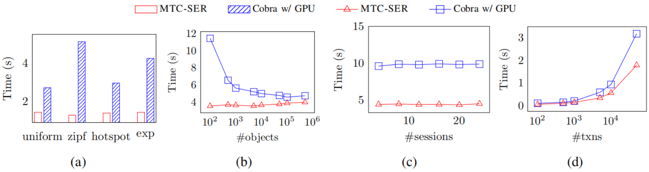
Q1: History Verification Performance vs. Cobra
MTC-SER outperforms Cobra, even under high concurrency and skewed access patterns
Up to 5× speedup and maintains stable performance as transactions or sessions increase
Notes:
MTC-SER consistently outperforms Cobra’s GPU accelerated version across various concurrency levels. For MT histories, Cobra exhibits similar overhead without GPU acceleration. Under highly skewed object access patterns,MTC-SER achieves about 5x(five times) better performance than Cobra (Figure a).
Additionally, MTC-SER maintains stable performance with respect to skewness, while Cobra’s verification time increases exponentially with fewer objects; see Figure b.
Both checkers maintain stable performance with respect to the number of sessions, yet MTC-SER consistently achieves around 2x(two times) better performance than Cobra (Figure c).
Furthermore, as the number of transactions increases, Cobra’s verification time escalates significantly faster (Figure d).

Slide 28
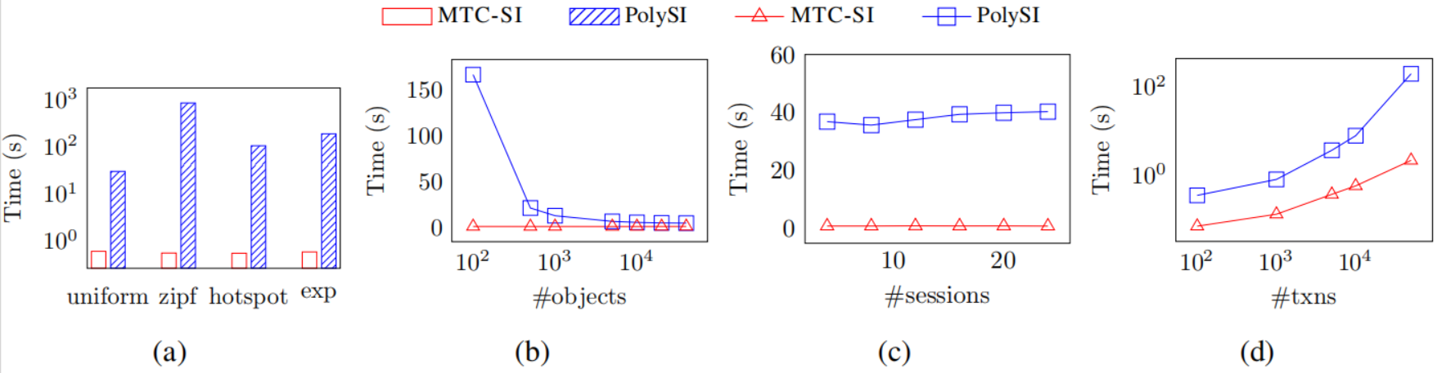
Q1: History Verification Performance vs. PolySI
MTC-SI achieves up to 1600× speedup under skewed workloads.
More stable and efficient than PolySI
Notes:
Compared to PolySI in verifying SI, MTC-SI demonstrates significantly greater performance gains across various work loads. MTC-SI can achieve about 1600x(one thousand six hundred times) faster verification (Figure a). With an increasing number of transactions,MTC-SI reduces verification time by up to 93x(ninety-three times) (Figure d).

Slide 29
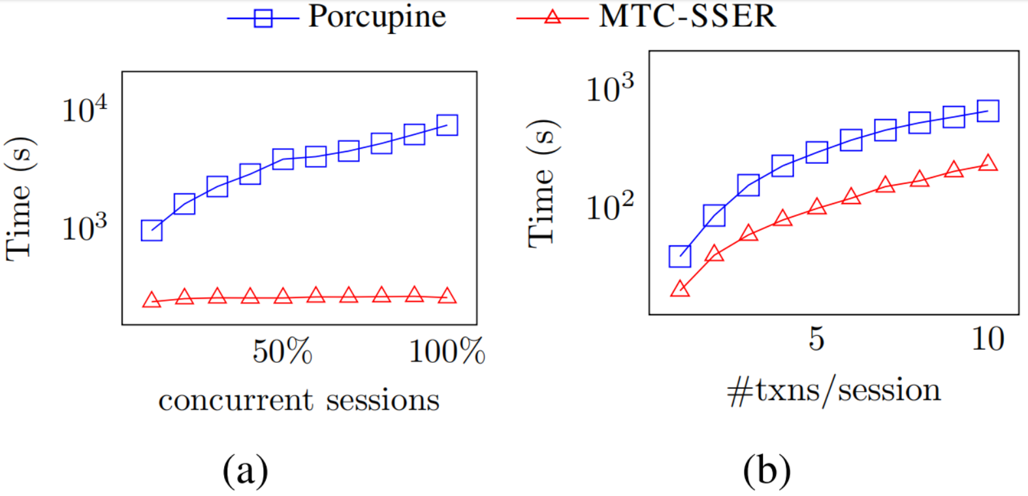
Q1: History Verification Performance vs. Porcupine
MTC-SSER achieves up to 28× speedup under full concurrency
More scalable and consistent than Porcupine
Notes:
As shown in Figure, MTC-SSER outperforms porcupine across various concurrency levels. Under extreme concurrency where all clients execute transactions at the same time, MTC SSER demonstrates a substantial 28x(twenty-eight times faster) improvement in verification. Furthermore, MTC-SSER maintains stable performance as the number of concurrent sessions increases (Figure a).

Slide 30
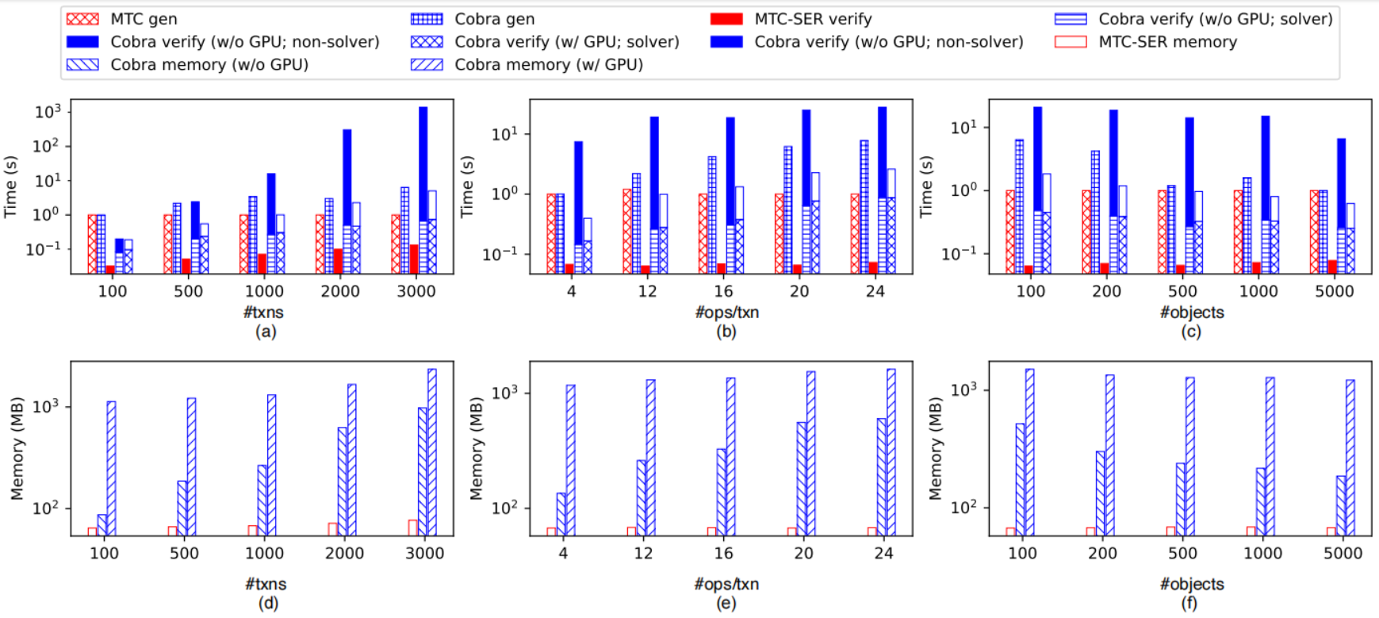
Q2: End-to-End Checking Performance vs. Cobra
MTC-SER achieves up to 1000× faster verification
Uses up to 30× less memory than Cobra
Notes:
To assess the performance improvement that MTs bring to the end-to-end isolation checking process, we compare base line checkers using their standard GT workload generators.
As shown in Figures a-c, MTC-SER with MT workloads substantially and consistently outperforms Cobra with GT workloads in both history generation and verification. Achieving up to two and three orders of greatness improvement in history verification compared to Cobra with and without GPU, respectively.
Additionally, as concurrency levels increase, MT workload generation becomes increasingly more efficient compared to Cobra.
Figures d-f show that MTC-SER consistently consumes significantly less memory than Cobra, achieving up to thirty times improvement compared to Cobra with GPU, and up to fourteen times without GPU.

Slide 31
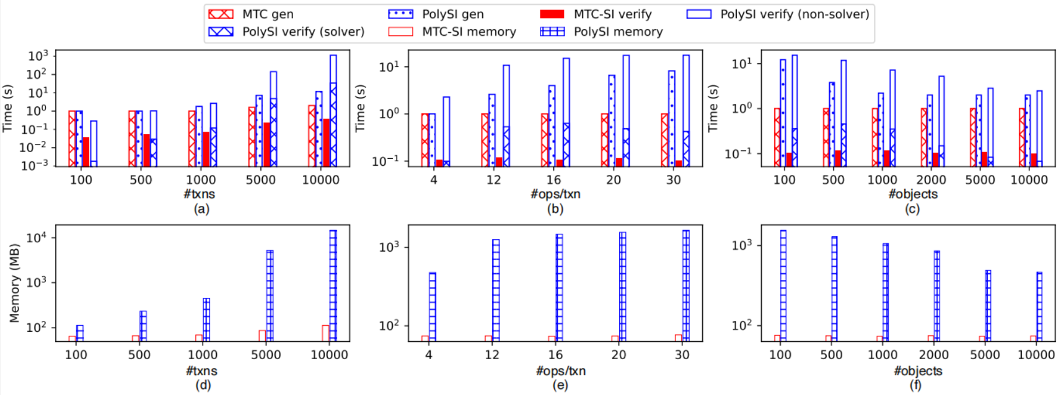
Q2: End-to-End Checking Performance vs. PolySI
MTC-SI is up to 100×–1000× faster
MTC-SI uses significantly less memory, up to 10×–100× smaller
Notes:
As shown in Figures,we observe similar trends in both time and memory in the end-to-end isolation checking comparison between MTC-SI and PolySI.

Slide 32
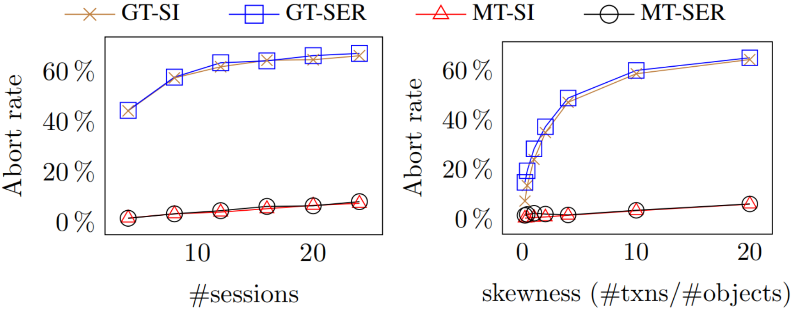
Q3: Effectiveness of Workload Generation
GT workloads suffer high abort rates (up to 60%)
MT workloads maintain low abort rates across settings
Notes:
Figure presents the abort rates for executing MT and GT workloads in PostgreSQL under SER and SI. For GT workloads, we use a moderate transaction size of 20 operations.
GT workloads result in substantially more aborted transactions, leading to less effective histories. As shown in Figure a, even with only a few client sessions, nearly half of the transactions are aborted. The abort rate increases as more sessions are involved, indicating greater stress on PostgreSQL. Moreover, the GT workload generator is sensitive to access skewness. In particular, when roughly 20 transactions access the same object, over 60% of transactions are aborted, as shown in Figure b. In contrast, our MT workload generator demonstrates robustness against variations in both cases.

Slide 33
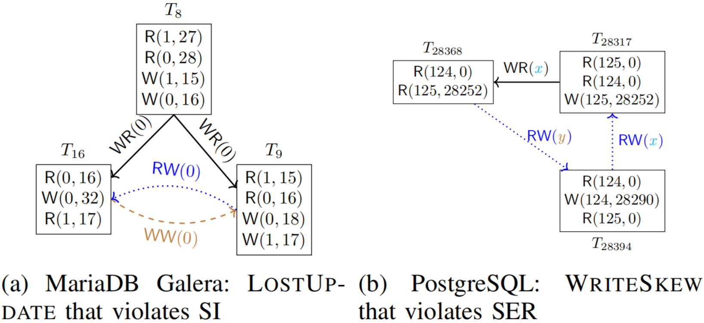
Q4: Detecting Isolation Bugs - Rediscovering Bugs
MTC successfully rediscovers real-world isolation anomalies
Each bug is captured using only a few concise Mini-Transactions
Notes:
MTC can successfully (re)discover real-world bugs across different isolation levels with MTs. For example, Figure a shows the LOSTUPDATE anomaly found in MariaDB which violates the claimed SI. Figure b describes the WRITESKEW anomaly found in PostgreSQL, which violates the claimed SER. Notably,the counterexamples returned by MTC are relatively concise and easy to interpret with MTs.﻿

Slide 34
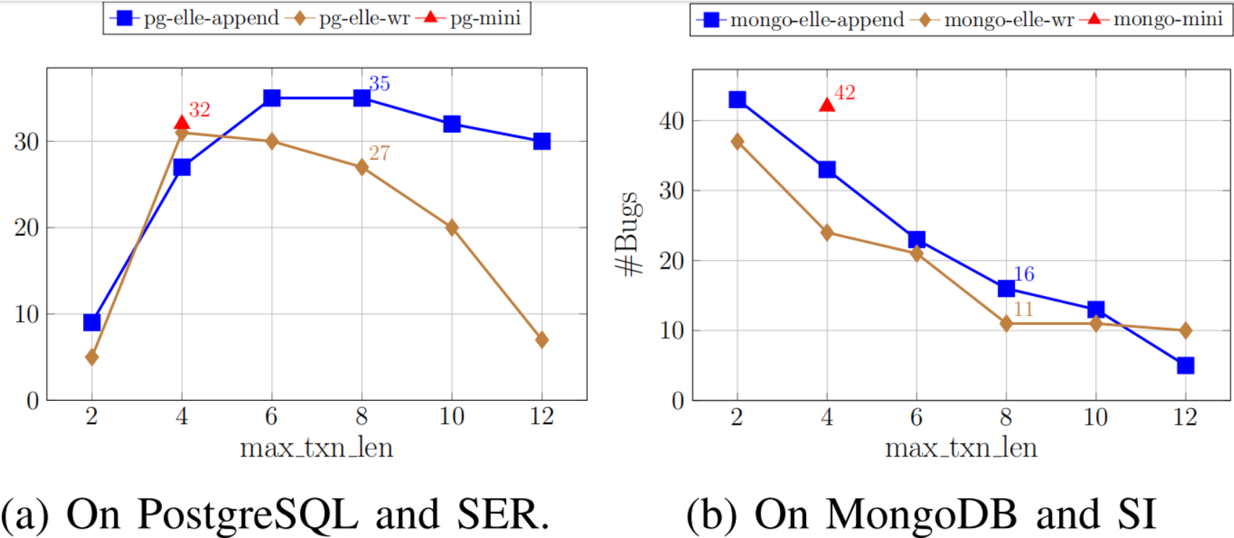
Q4: Detecting Isolation Bugs - Effectiveness
MTC consistently detects more bugs than Elle-wr and Elle-append
Robust across transaction sizes and workloads
Notes:
As shown in Figure a, within 30 minutes, MTC detects bugs in 32 successful trials on PostgreSQL, while Elle achieves the highest bug detection rate with 35 successful trials at a maximum transaction length of 8 operations under the list append workload.
On the other hand, MTC consistently detects bugs in more successful trials than Elle under the read-write register workload. On MongoDB (Figure b), MTC is also highly competitive in bug detection compared to Elle.

Slide 35
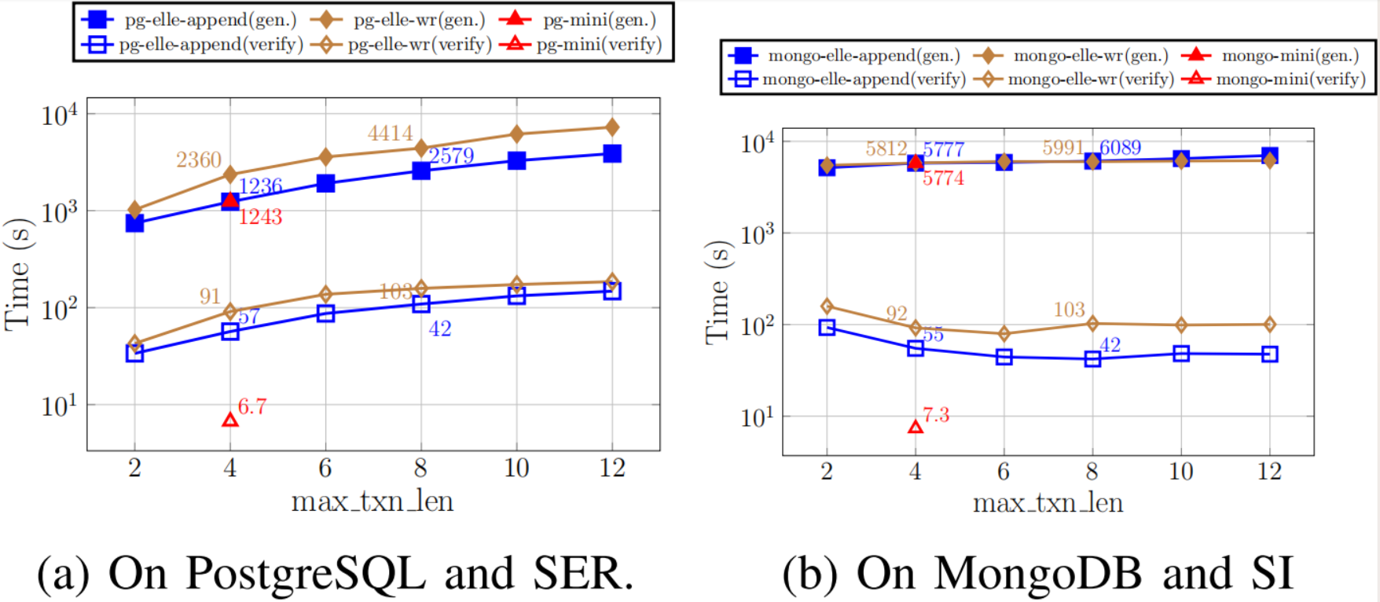
Q4: Detecting Isolation Bugs - Effectiveness
MTC outperforms Elle in both history generation and verification time
Up to 15× faster verification and 3.5× faster generation on PostgreSQL
Notes:
We also report the average time for history generation and verification for MTC and Elle. Figure shows that MTC consistently outperforms Elle in both tasks. For example, on PostgreSQL with a maximum transaction length of 8 operations under a read-write register workload, MTC achieves up to 3.5x(three point five times) and 15x(fifteen times) speedups in history generation and verification, respectively.

Slide 36
Summary
Propose a unified approach centered on MTs to address inefficiencies in both history generation and history verification.
Design MTs to capture all 14 known anomalies and develop efficient verification algorithms using RMW patterns and unique values.
Implement MTC tool that outperforms existing checkers and effectively detects bugs in real databases.
Notes:
In summary,we propose a unified MT-based approach for efficient history generation and verification.
We design compact Mini-Transactions that capture all 14 isolation anomalies, and prove strong isolation checking without unique values is NP-hard.﻿
We build the MTC tool, which outperforms existing checkers and detects real-world bugs across isolation levels.

Slide 37
Discussion & Future work
Discussion:
Elle’s bug detection is sensitive to transaction size, while MTs remain effective with size 4 as baseline
A key challenge is accurate timestamp collection while handling clock skew
Future work:
Test MTC on FaunaDB and VoltDB with general MTs
Extend MTC to support weaker isolation levels
Add support for predicate-based checking
Notes:
In our discussion,we observe that Elle’s effectiveness in bug detection is highly sensitive to transaction sizes across databases, whereas a transaction size of 4 serves as a baseline.A key challenge is to accurately collect transaction start and finish wall-clock timestamps, while handling potential clock skew.
As for future work, We plan to evaluate MTC’s performance in verifying SSER by conducting experiments on FaunaDB and VoltDB.
Furthermore,We aim to extend MTC to support weaker isolation levels and even predicate-based verification, to further broaden its applicability.

Slide 38

欢迎批评指正
nayang@smail.nju.edu.cn
May 23，2025
Notes:
Thank you for your attention. I welcome your questions.

